Slide 1
Big Data Project -Leandro Oliveira

Slide 2
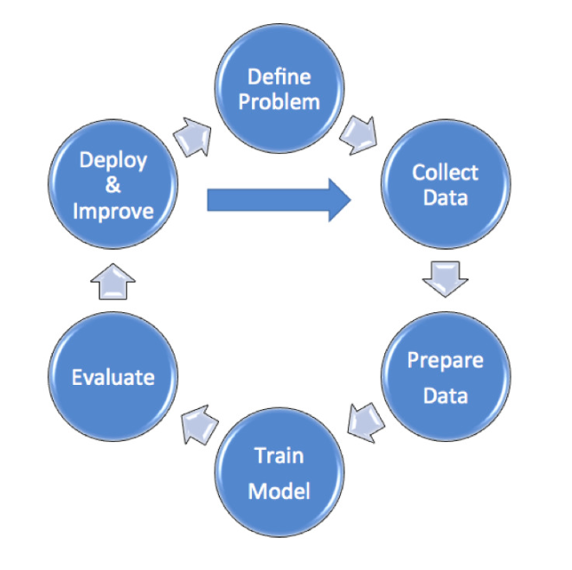
Learning Process Steps in Machine Learning

Slide 3
Learning Process Steps in Machine Learning
DEFINE PROBLEM AND DATA COLLECT- The problems definition steps and collecting data have already been performed.
PREPARE DATA - Normalization process and missing values treatment has been applied before. Anyway, as we find only 1,25% missing values, this does not generate much interference.
TRAIN MODEL – For all models, we apply the training procedure (70%) and test (30%)
EVALUATE - The k value minimum considered is 70%.
DEPLOY AND IMPROVE – This process considers future applications and adjustments, considering the entry of new future data.

Slide 4
Aim of Analysis
Identify patterns of consumption behavior based on electrical energy consumption by applying the machine learning method in order to support making decision in the formulation of public energy policies.
Identify the best clustering results for different k values

Slide 5
Dataset
Data Set Information
This archive contains 2075259 measurements gathered in a house located in Sceaux (7km of Paris, France) between December 2006 and November 2010 (47 months).
Source:https://archive.ics.uci.edu/ml/datasets/individual+household+electric+power+consumption

Slide 6
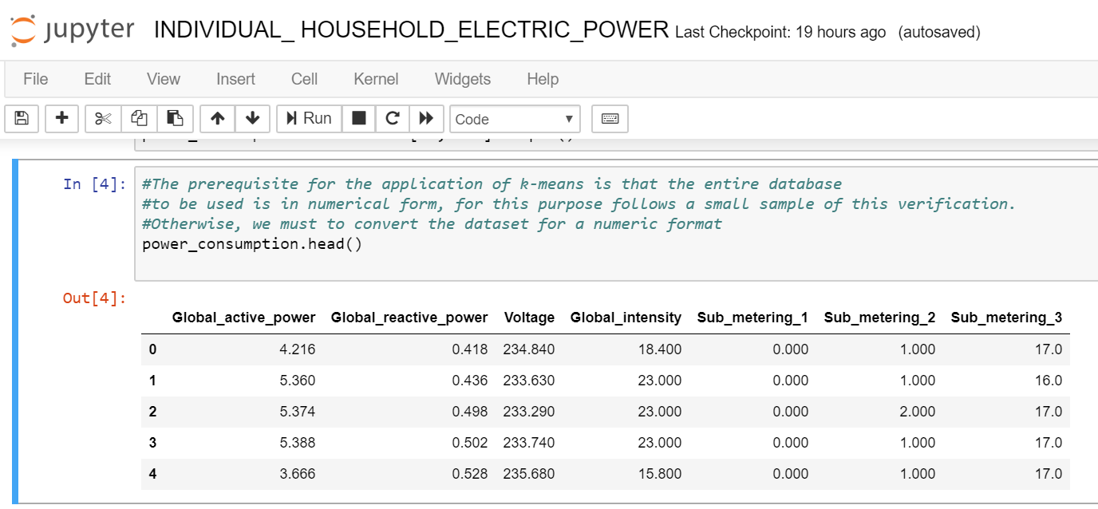
Dataset

Slide 7
Data Preparation
The data does have missing values about 1.25% of the rows (about 82 days). We can notice that the number of missing values is relatively small compared to the size of the database. So, it’s not harmful to the model if we delete these missing values.
Get attributes and split into training and test datasets
Applies dimensionality reduction.
We used the Principal Component Analysis (PCA), it is a simple yet popular and useful linear transformation technique that applie dimensionality reduction.
we are not reducing the numbers of variables, we only collected all variances from the variables and input it in 2 components and these components represents the same variables information
so now we can work with only these 2 components to make predictions

Slide 8
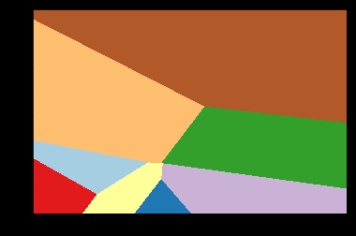
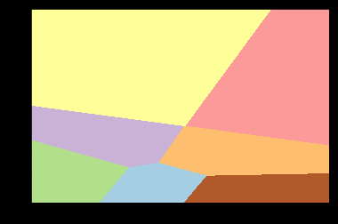
Area Clusters Plot Analyse for k = 8 and k =7
K = 8
K = 7
Each color area represent a cluster area

Slide 9
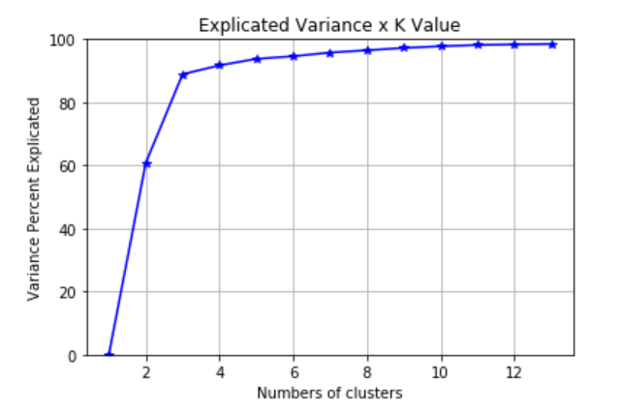
Elbow Curv
The Elbow Curv calculate the variance resulted of the Total Sum of the Squares - Sum of the Squares of distances inside of clusters. From this result we know that for each k value we can understand the variance value.
The Explicated Variance x K Value graphic show us that for k value >= 4 the variance could be more explicated

Slide 10
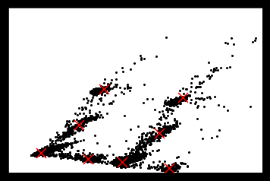
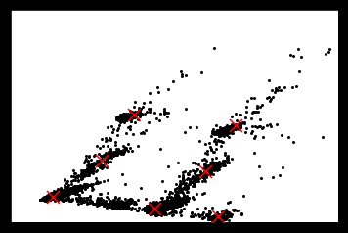
Area Clusters Plot Analyse for k = 8 and k =7
K = 8
K = 7
Each color area represent a cluster area

Slide 11
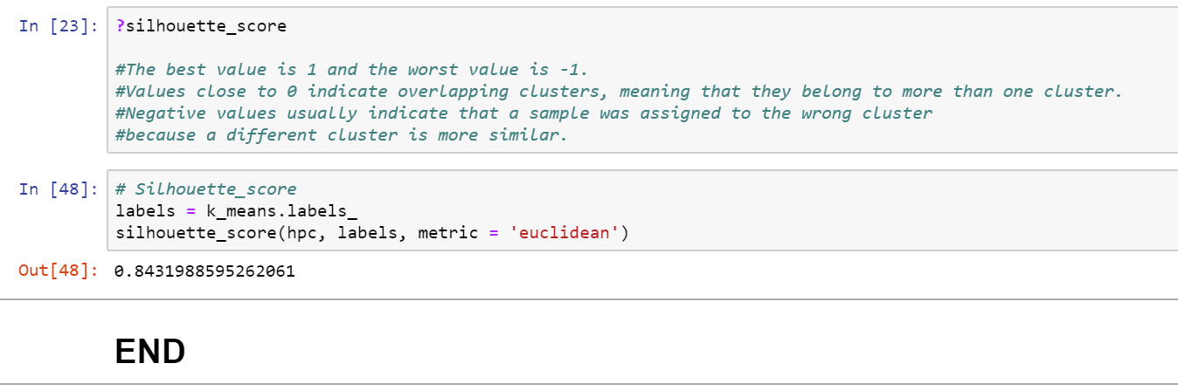
Conclusion
We conclude that the final value above 80% is satisfactory to consider about the patterns of consumption behavior based on electrical energy consumption by applying the machine learning method in order to support making decision in the formulation of public energy policies.

